Slide 1

Predicting Household Income
Group 4

Slide 2
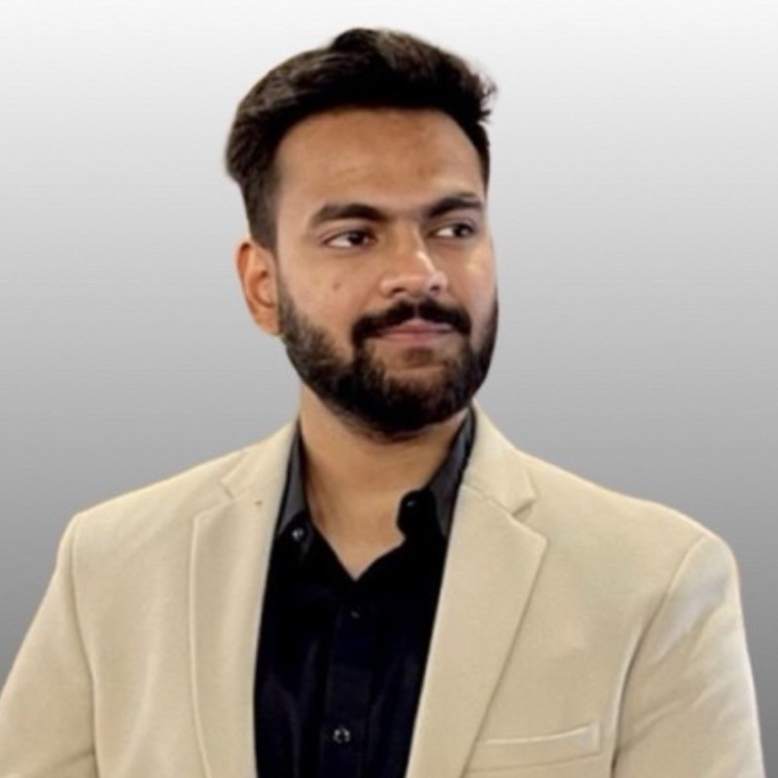
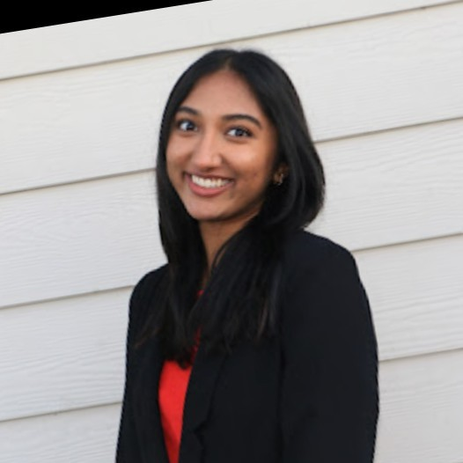



OUR TEAM
Pranav
Garg
Brinda
Asuri
Akash Barathan
Haoyi
Zhou
Mykyta
Zavhorodko

Slide 3




Agenda
INTRODUCTION
EDA/Insights
OUR PROCESS
OUTCOMES

Slide 4

Main Question
How do 5 years of historical data (2017-2021) on various U.S. census features, affect future median household income values?

Slide 5

Our Dataset
Atlas of Rural and Small-Town America from USDA
Target Variable: median household income
4 datasets: jobs, income, people, and veterans
merged using common identifiers: FIPS, State, and County
173 N/A values
3279 observations
215 predictor variables

Slide 6

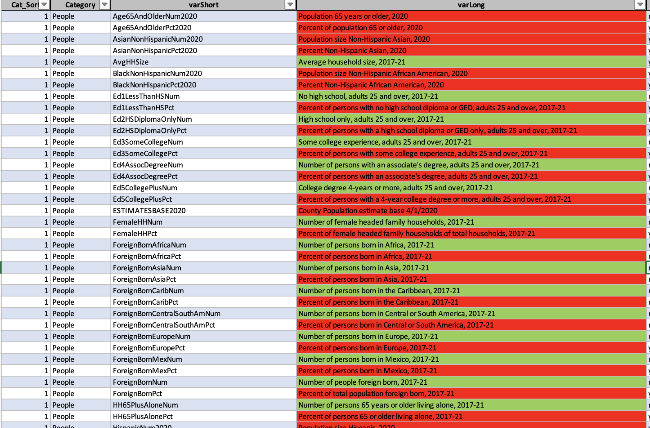
EDA
before cleaning
215 features
after cleaning
98 features
Notes:
215 - 98

Slide 7
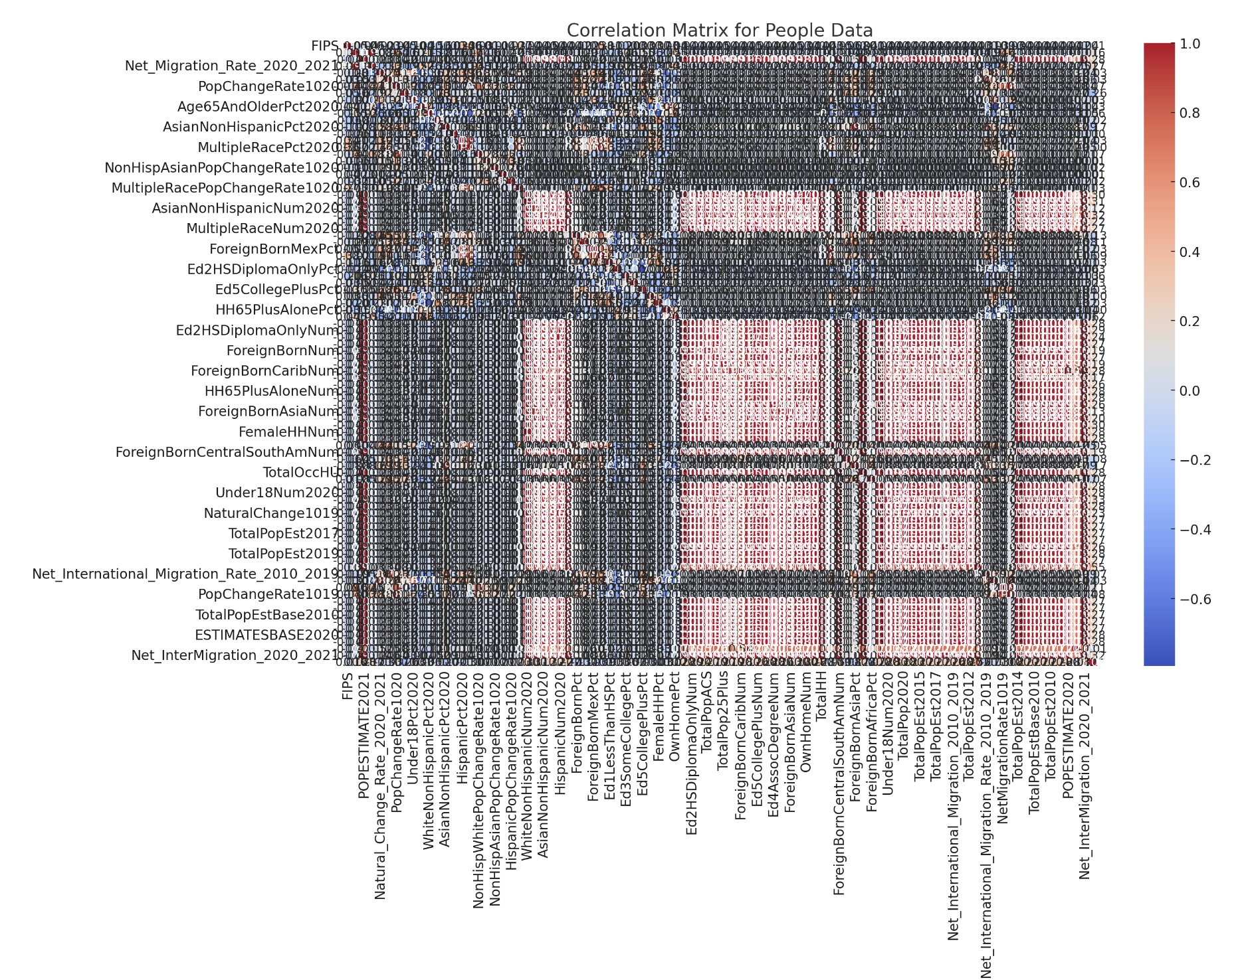
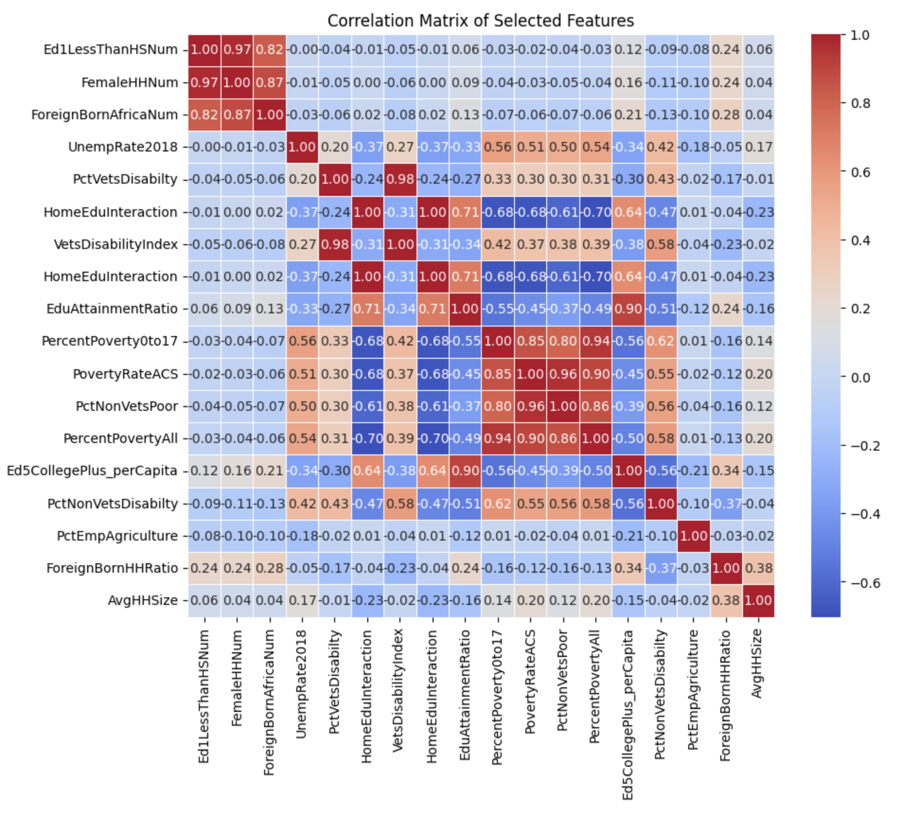
EDA
Before
After

Slide 8
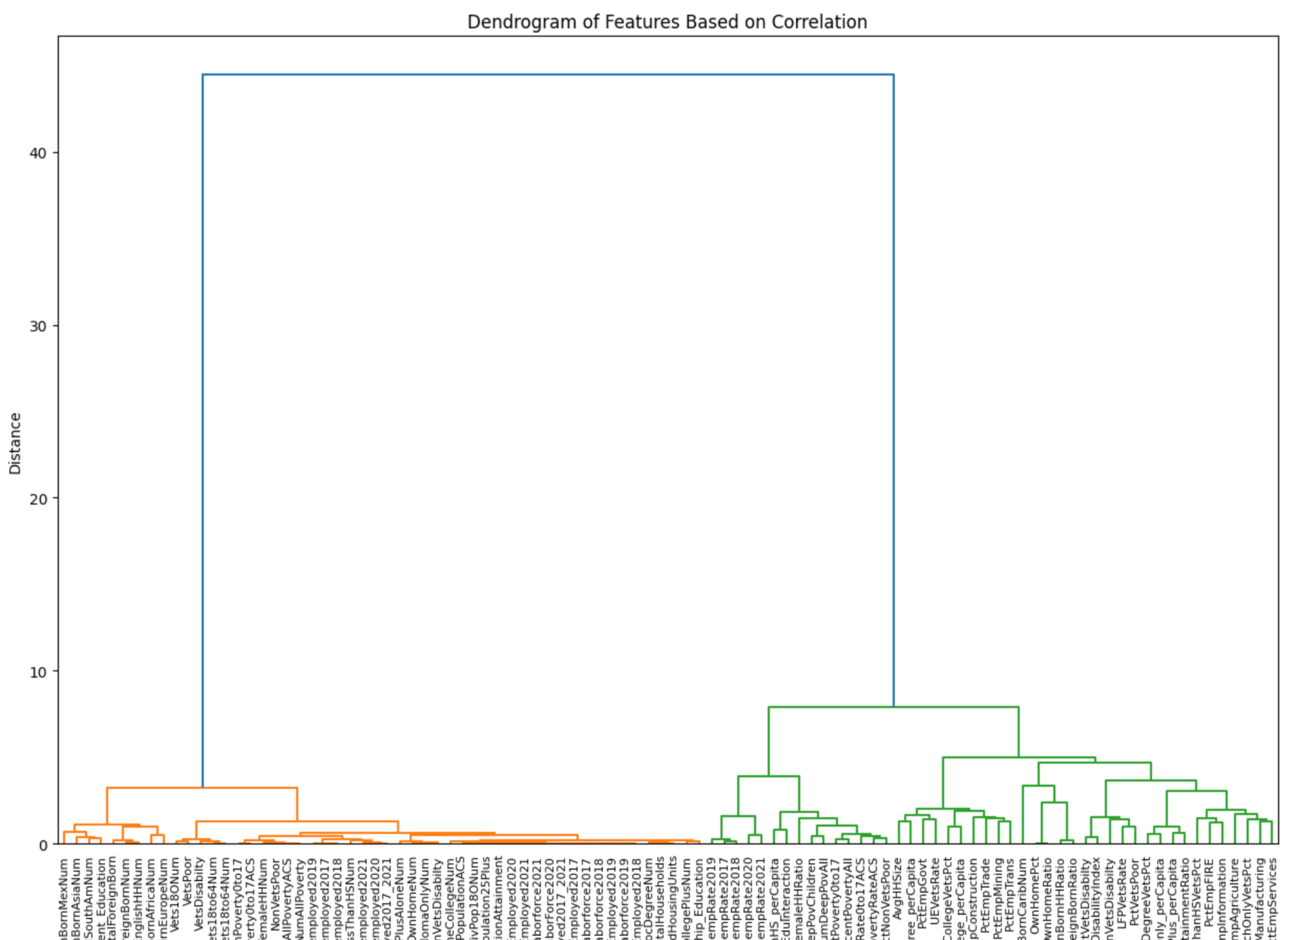
EDA

Slide 9
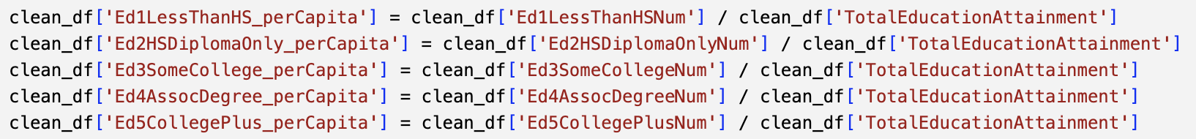
EDA
Feature Engineering
average number of employed and unemployed from 2017-2021
aggregate to create new features representing the total counts of certain categories.
normalize different education level /total count

Slide 10
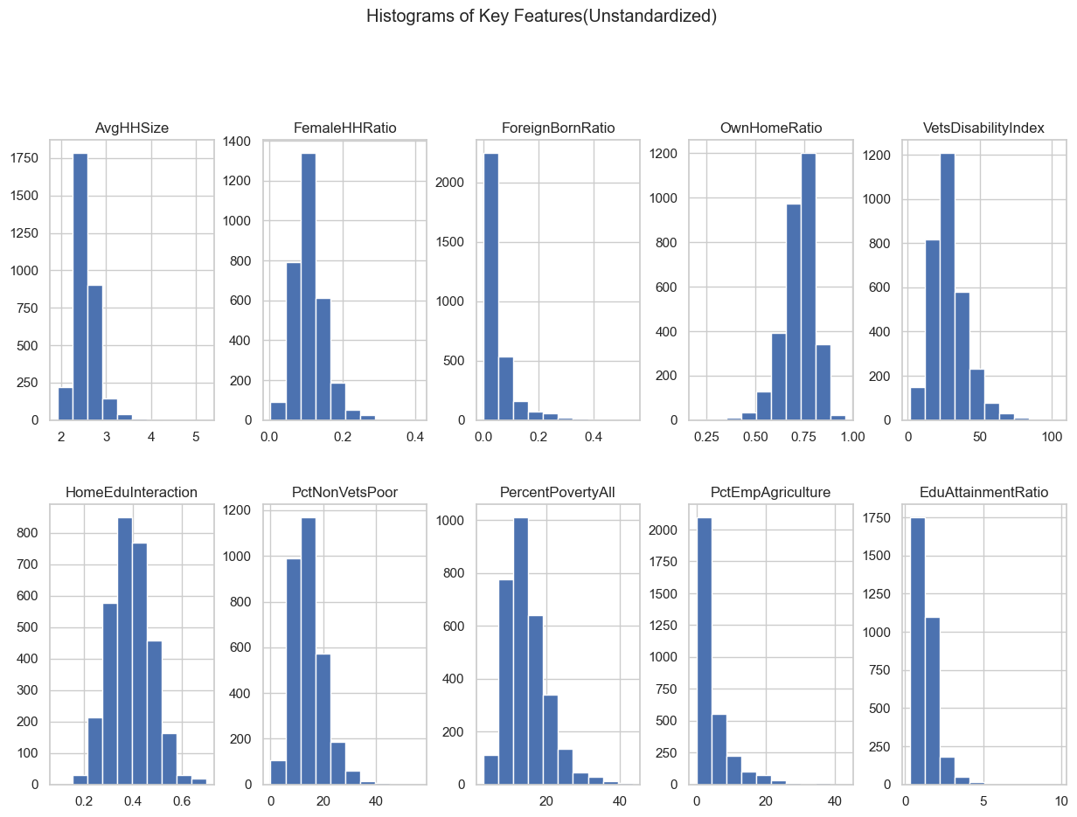

Data Insights
Unstandardized Data

Slide 11
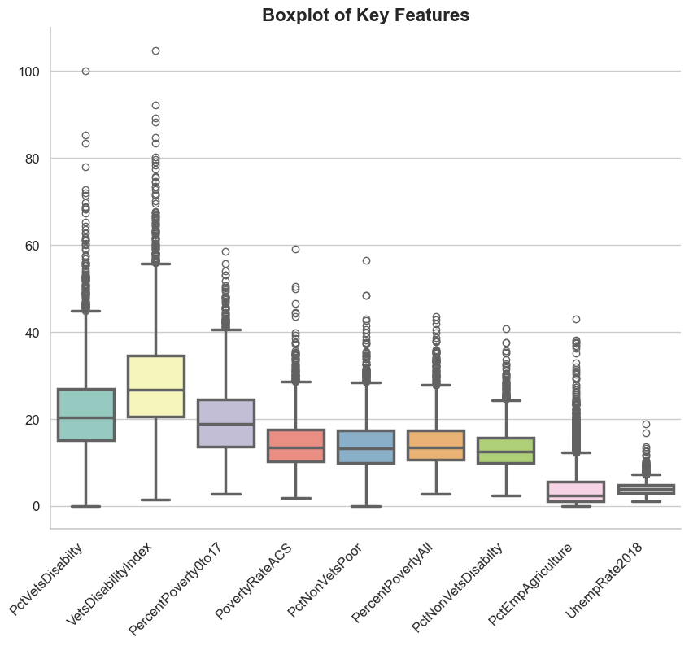
Data Insights
Unstandardized Data

Slide 12
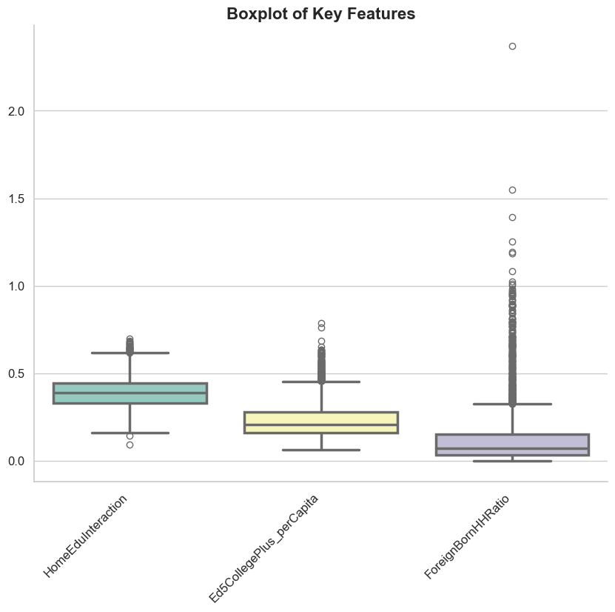
Data Insights
Unstandardized Data

Slide 13
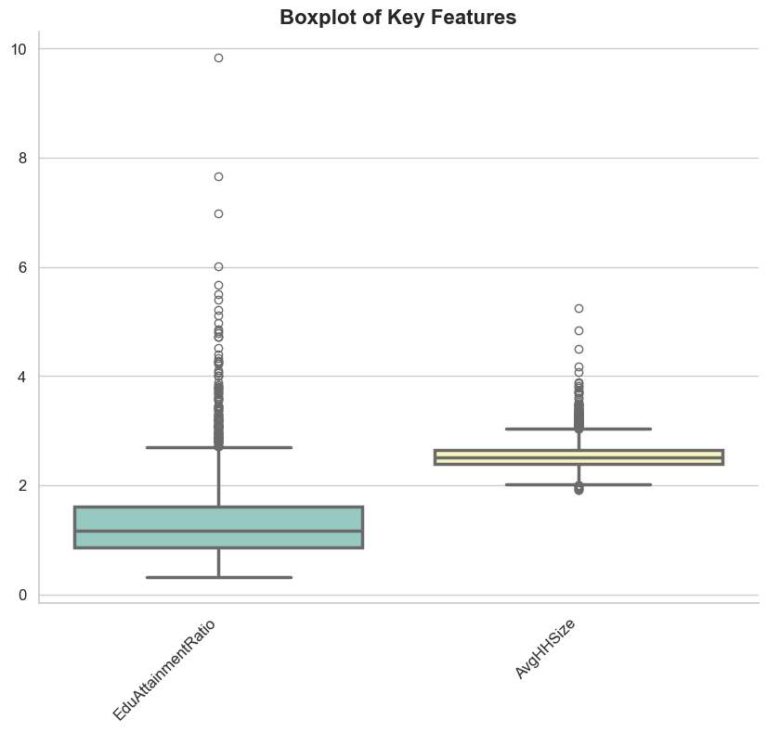
Data Insights
Unstandardized Data

Slide 14
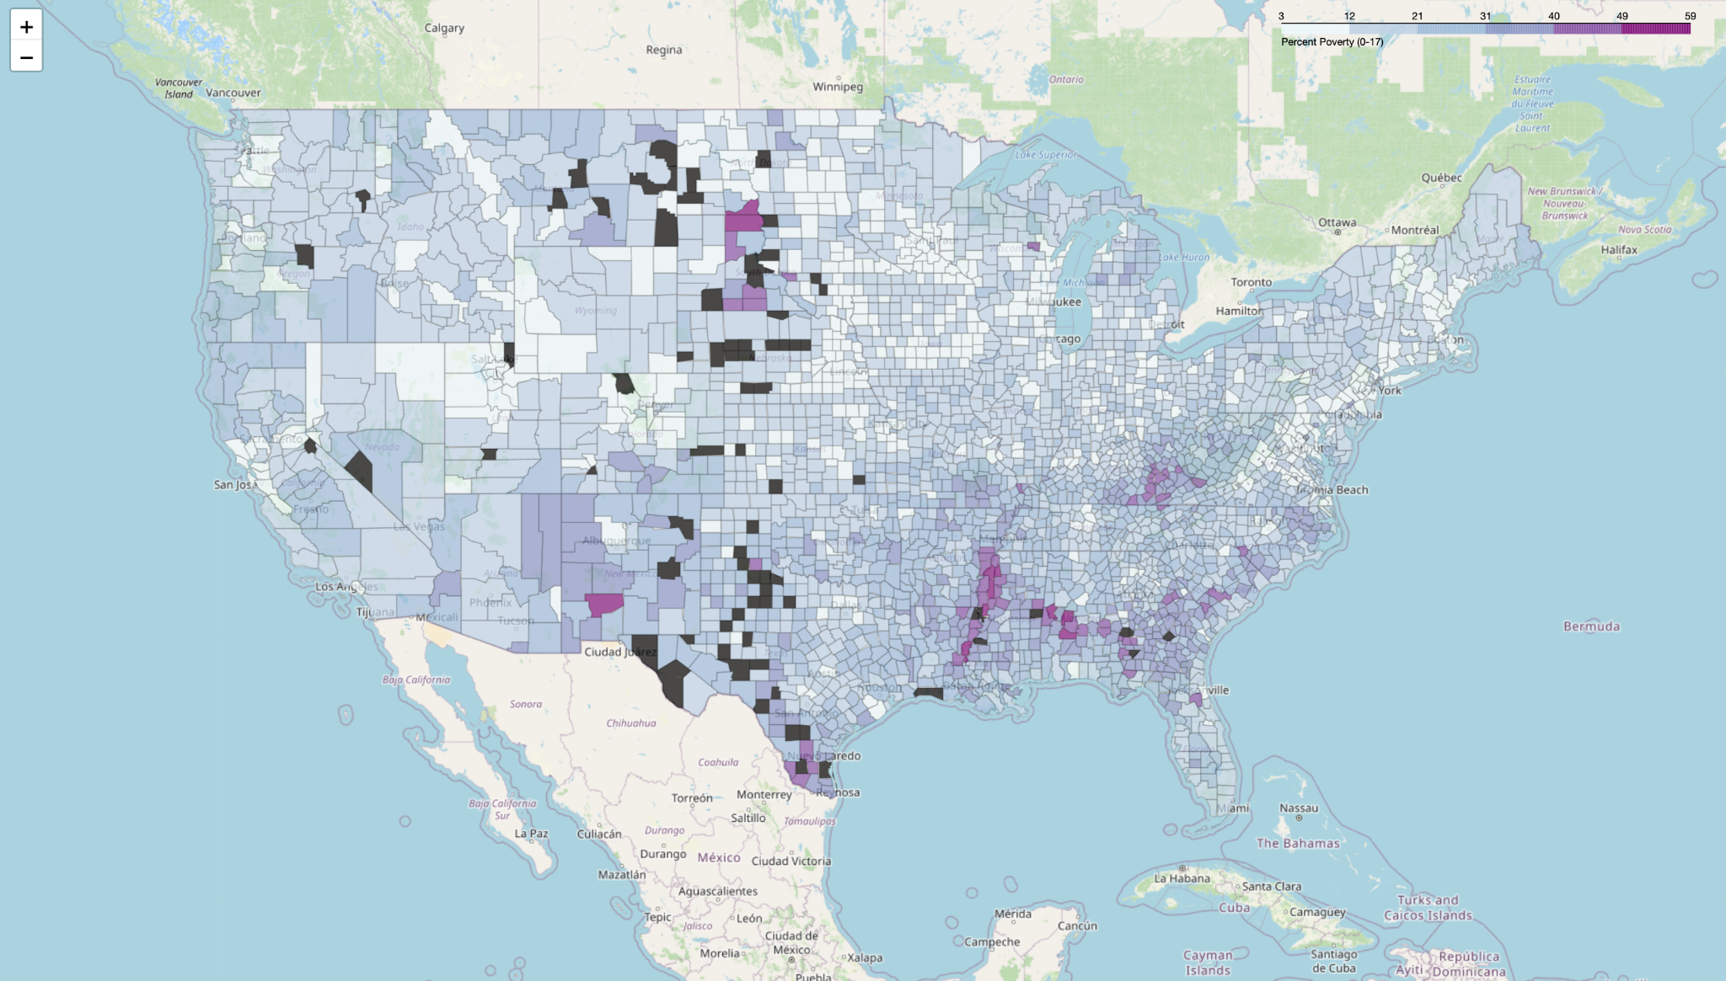
Data Insights
Distribution of Poverty from 0-17 in different Counties

Slide 15
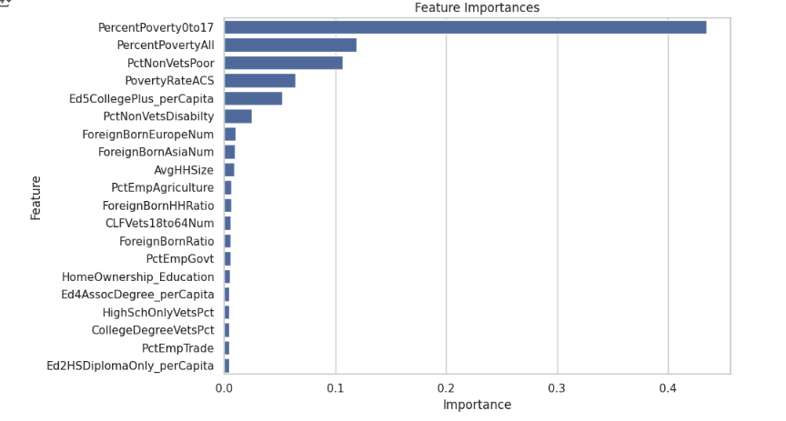
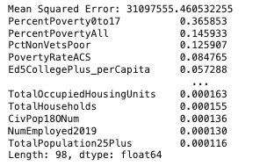
Random Forests
PercentPoverty0to17
HomeOwnership_Education
PovertyRateACS
PctNonVetsPoor
PercentPovertyAll
Ed5CollegePlus_perCapita
RMSE: 5582

Slide 16
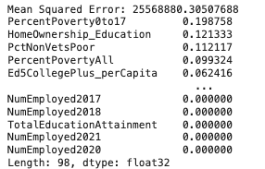
XG Boosting
Hyperparameters:
Depth of tree: 3
Number of trees: 200
Learning rate: 0.1
RMSE: 5056
Important features:
PercentPoverty0to17
HomeOwnership_Education
PctNonVetsPoor
PercentPovertyAll
Ed5CollegePlus_perCapita

Slide 17
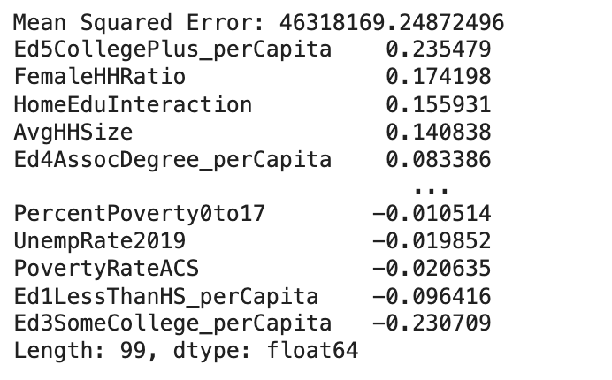
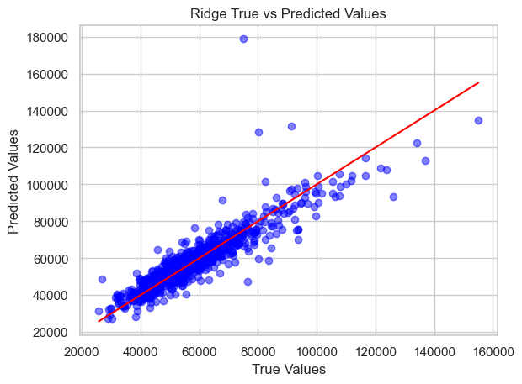
Ridge Regression
RMSE: 6769

Slide 18
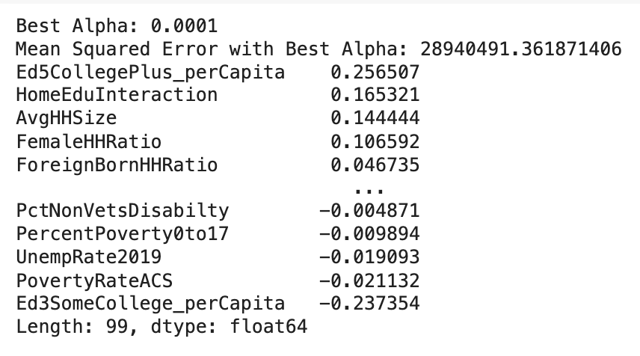
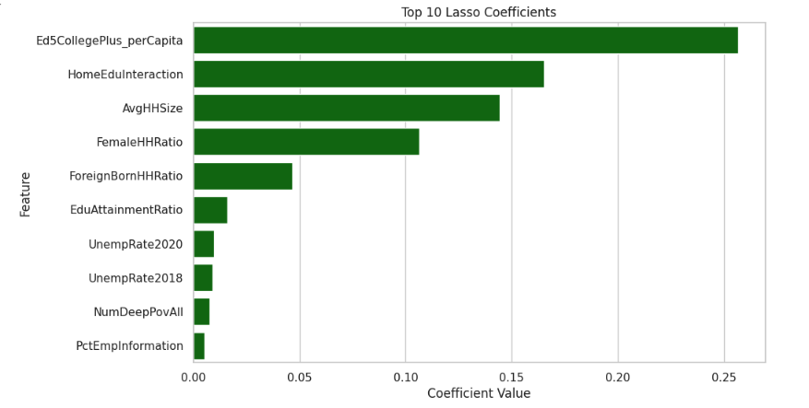
Lasso Regression
RMSE: 5379
Important features:
Ed5CollegePlus_perCapita
HomeEduInteraction
AvgHHSize
FemaleHHRatio ​​
ForeignBornHHRatio

Slide 19
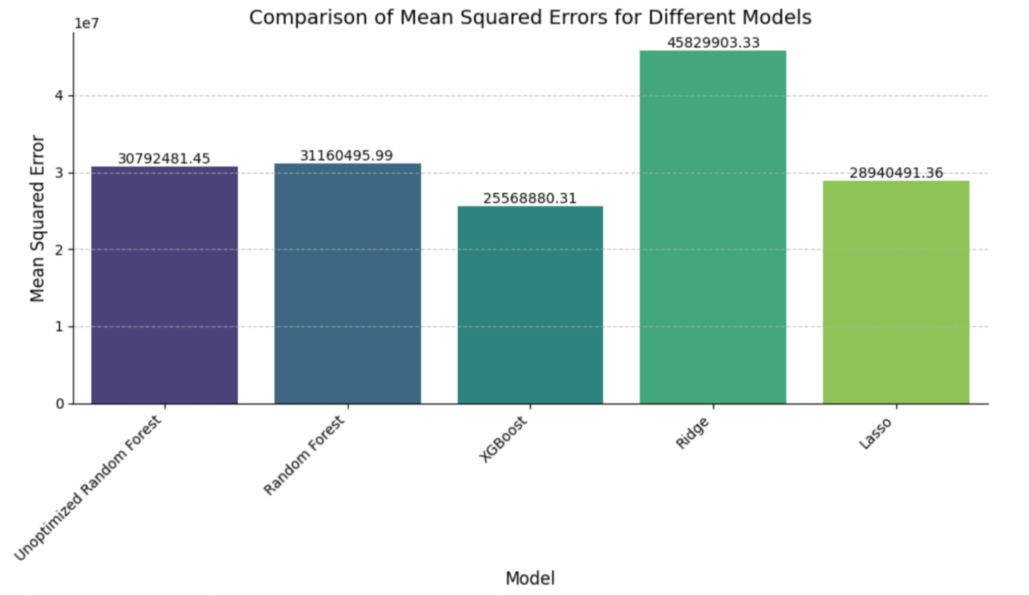

Summary of Results

Slide 20
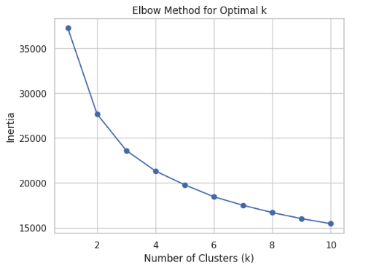
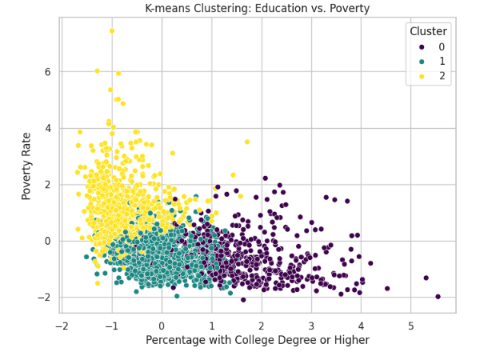
K-MEANS Clustering

Slide 21


Future Considerations
Decrease any multicollinearity and account better for all outliers
Narrow the scope of the project on specific types of counties

Slide 22

Thank you!
Questions?

